Slide 1
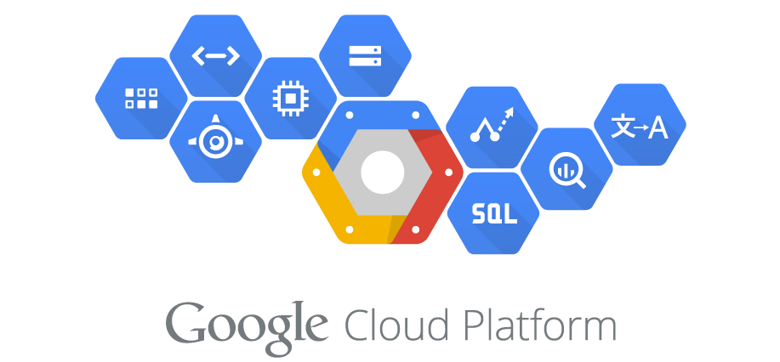
Google Cloud Platform
Presented By: Rajesh Wadhe & Sanvid Punde

Slide 2
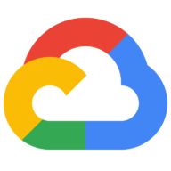
What is GCP?
The Google Cloud Platform (GCP) is a suite of cloud services hosted on Google's infrastructure.
From computing and storage, to data analytics, machine learning, and networking, GCP offers a wide variety of services and APIs that can be integrated with any cloud-computing application or project, be it personal or enterprise-grade.
Google Compute Engine was launched in June 2012 (with general availability in December 2013).

Slide 3
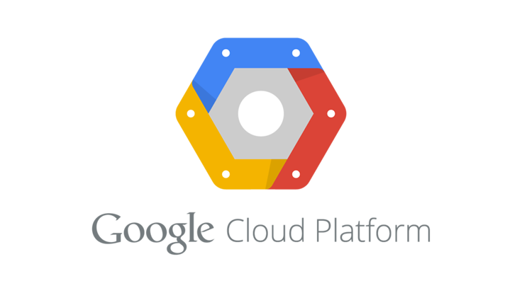
Why Google Cloud?
Google Cloud is underpinned by the same infrastructure and innovation that powers google products.
Solid Infrastructure
Top Tier Data Analytics
Serverless computing
Customer favoring pricing
Innovative
Security

Slide 4
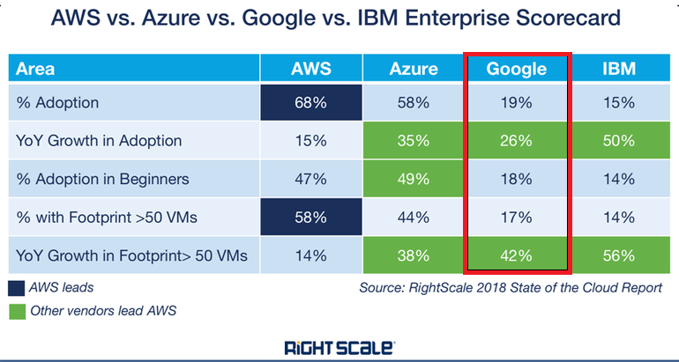
Adoption Rates for Different Cloud Platforms

Slide 5
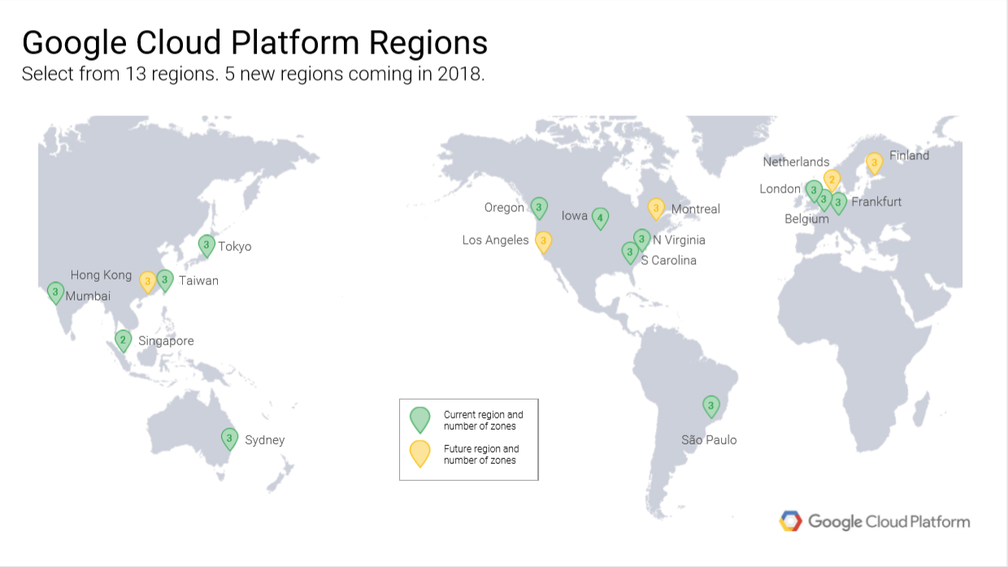

Slide 6
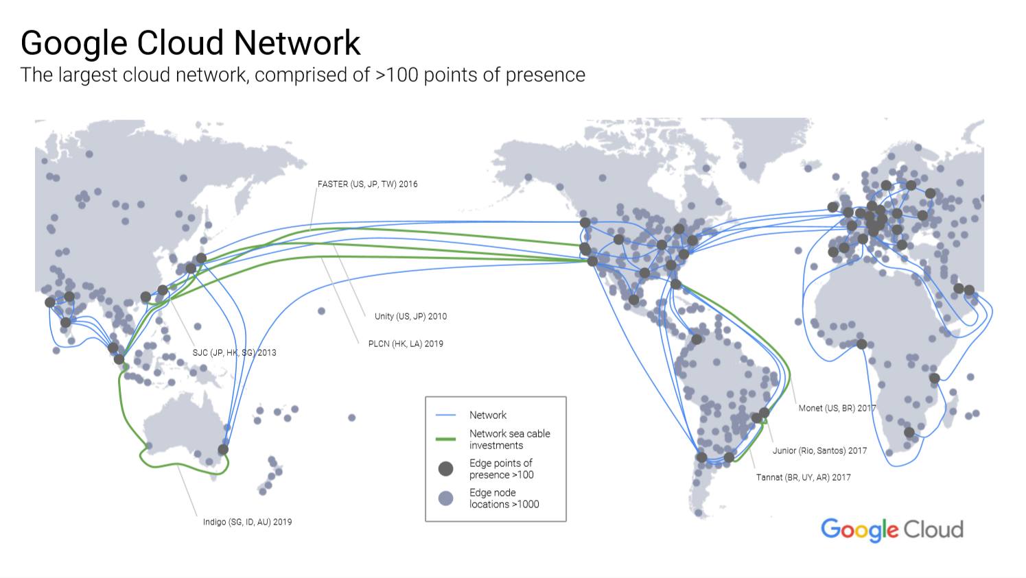

Slide 7
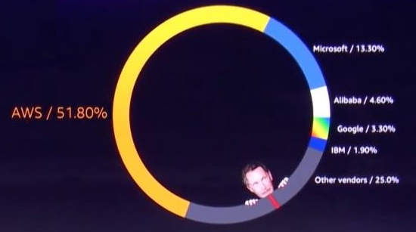
State of the cloud 2018

Slide 8
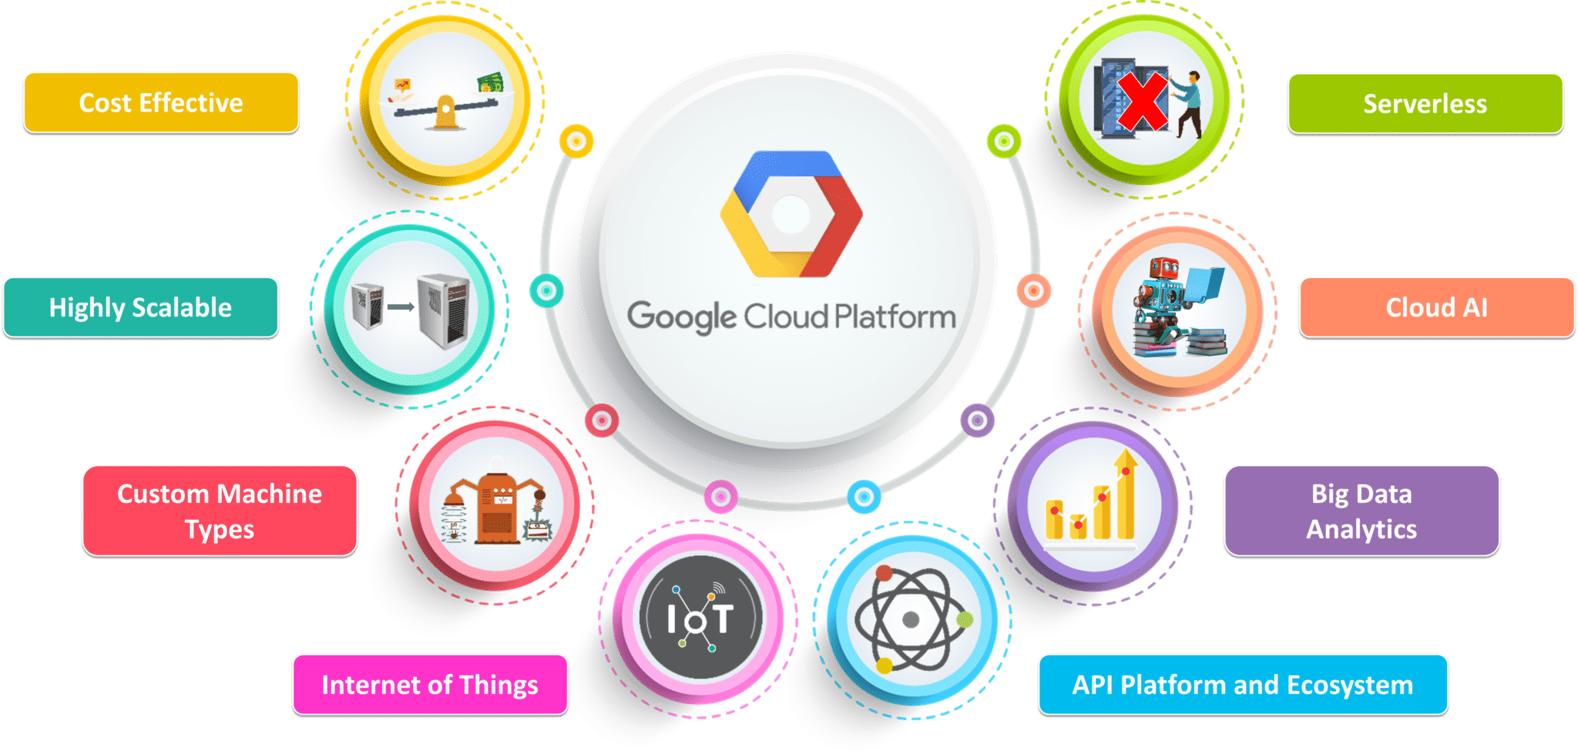
GCP Characteristics

Slide 9
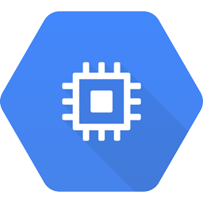
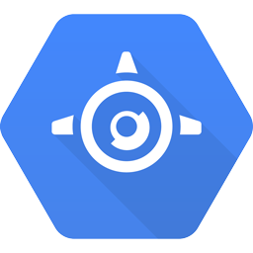
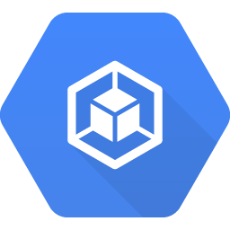
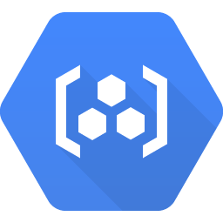
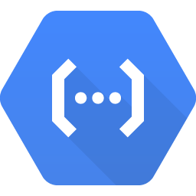

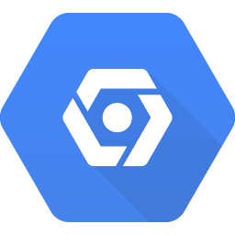
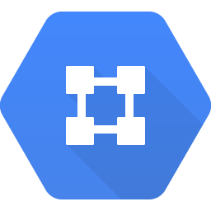
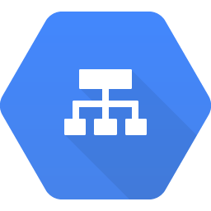
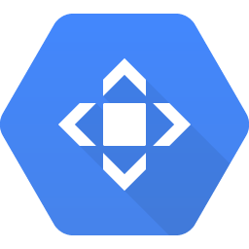
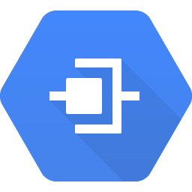
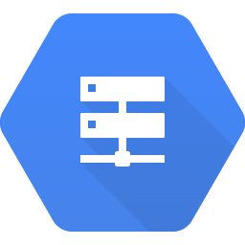
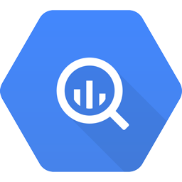
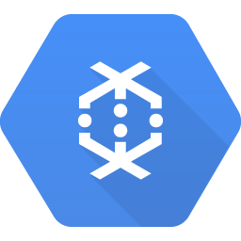
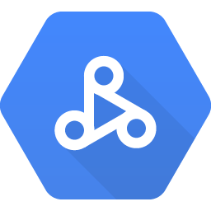

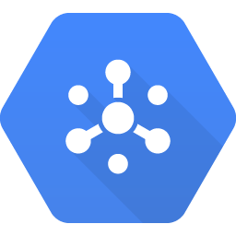
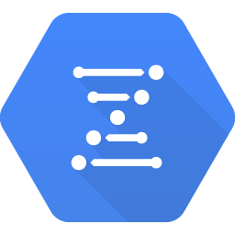
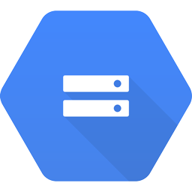
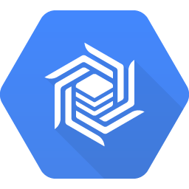
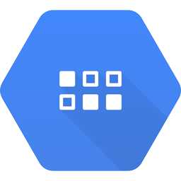
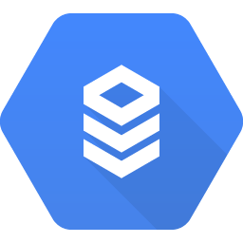
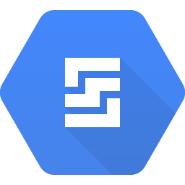
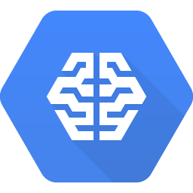

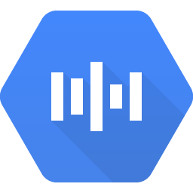
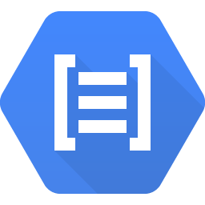
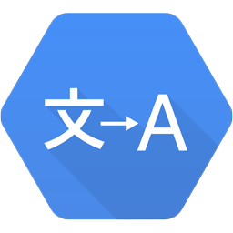
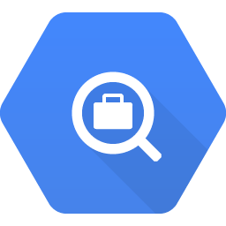
GCP Services
Compute
Identity & Security
Entire Suite of GCP Services.
Services and its Sub Services
Compute Engine
App Engine
Container Engine
Container Registry
Cloud Functions
Cloud IAM
Cloud Resource Manager
Cloud Security Scanner
Cloud Platform Security
Networking
Big Data
Cloud Virtual Network
Access & Analysis
Cloud Load Balancing
Cloud CDN
Cloud Interconnect
Cloud DNS
BigQuery
Cloud Dataflow
Cloud Dataproc
Cloud Datalab
Cloud Pub/Sub
Genomics
Storage and Databases
Machine Learning
Cloud Storage
Cloud Bigtable
Cloud Datastore
Cloud SQL
Persistent Disk
Cloud Machine Learning
Vision API
Speech API
Natural Language API
Translation API
Jobs API

Slide 10
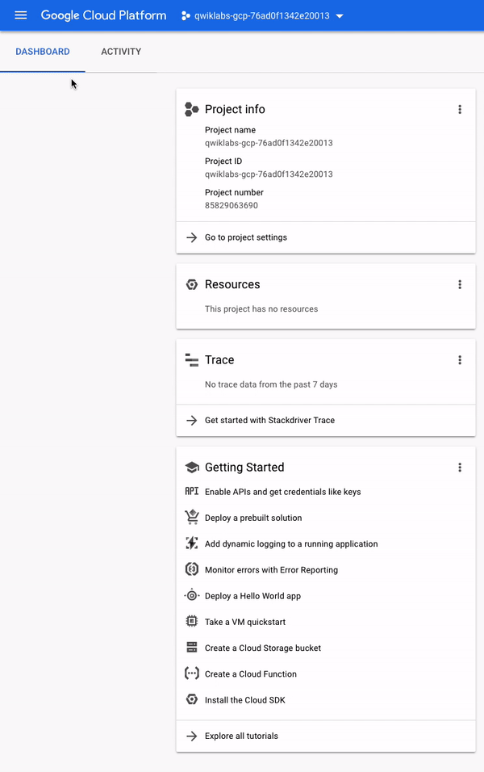
GCP Dashboard
Clicking on this will reveal (or hide) a navigation menu that points to GCP's core services click on the icon now and scroll through so we can see all the services provided.

Slide 11
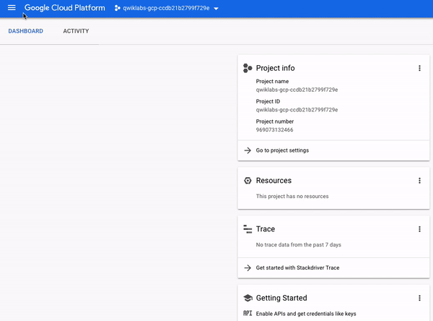
GCP API & Services
APIs are "Application Programming Interfaces" that you can call directly.
Most Cloud APIs provide you with detailed information on your project’s usage of that API, including traffic levels, error rates, and even latencies, helping you to quickly triage problems with applications that use Google services.

Slide 12

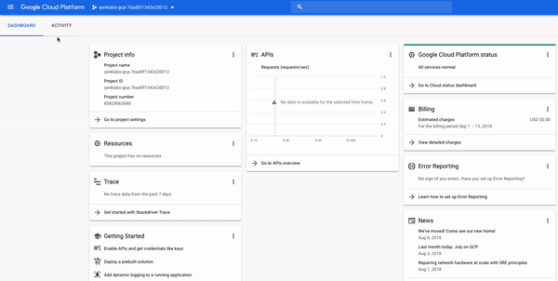

GCP IAM (Identity & Access Management)
Cloud computing with GCP also houses a collection of permissions and roles that define who has access to what resources. We can use the Cloud Identity and Access Management (IAM) service to inspect and modify such roles and permissions.
12
Copyright © 2018, Saama Technologies | Confidential

Slide 13


GCP Compute Engine
Google Compute Engine provides a scalable number of virtual machines (VMs) to serve as large compute clusters for that purpose and can monitor VM instances, persistent disks, VM images.
GCE can be managed through a RESTful API, command line interface (CLI) or Web console. Compute Engine is a pay-per-usage service
13
13
Copyright © 2018, Saama Technologies | Confidential

Slide 14
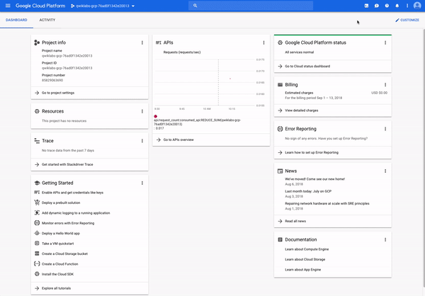
GCP Cloud Shell
GCP Shell provides us with command-line access to our cloud resources directly from your browser.
We can easily manage our projects and resources without having to install the Google Cloud SDK or other tools on our system.

Slide 15
GCP Strengths
Google's strategy for GCP centers on making it’s own services available to other companies that can be purchased.
Better pricing and availability than other competitors.
Private global fibre & it’s Tiered Network, being one the biggest in the world.
Machine learning services advantage over other cloud platforms.
Commitment to open source and portability.

Slide 16

GCP Cautions
GCP positions itself as the cost leader in the market, but its deepest negotiated discounts are usually limited to a single-year contract.
Fewer features and services because of late entry to IaaS market.
Fewer worldwide data centers.
16

Slide 17
Future of GCP
Google will continue to release out new functionality for its customers, its pace of innovation for Google Cloud Platform has yet to match that of either AWS or Azure.
In short, unless Google gets its serverless act together—and soon—it risks losing the momentum it has managed to build over the past year. Serverless computing is the future.

Slide 18
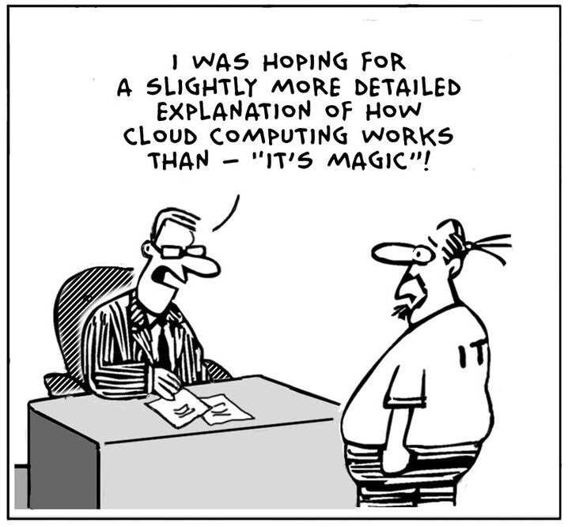
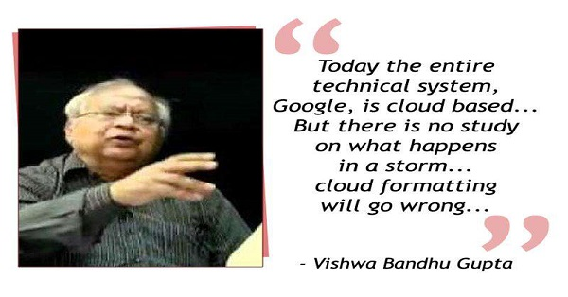

Slide 19
Thank You!

